Slide 1


Slide 2
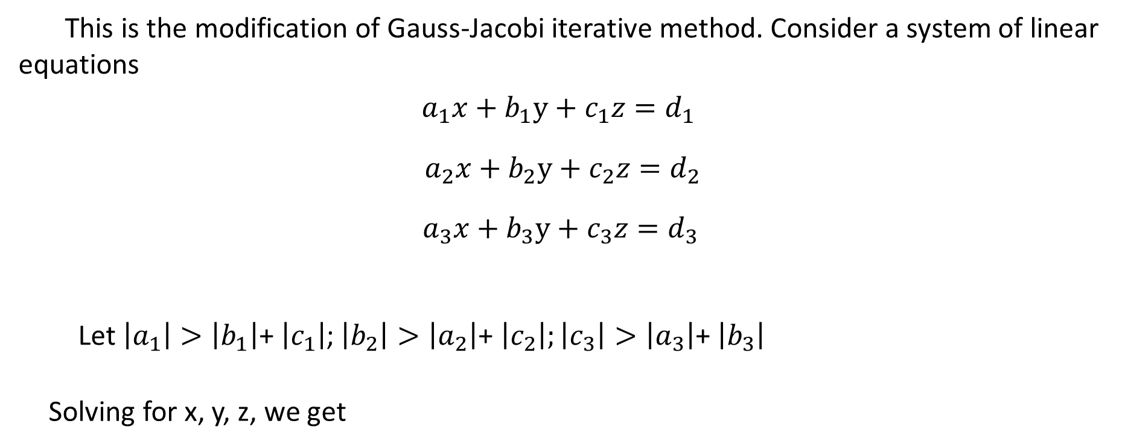

Numerical Methods
Gauss-Seidel Iterative Method
National University of Science and Technology, Islamabad

Slide 3
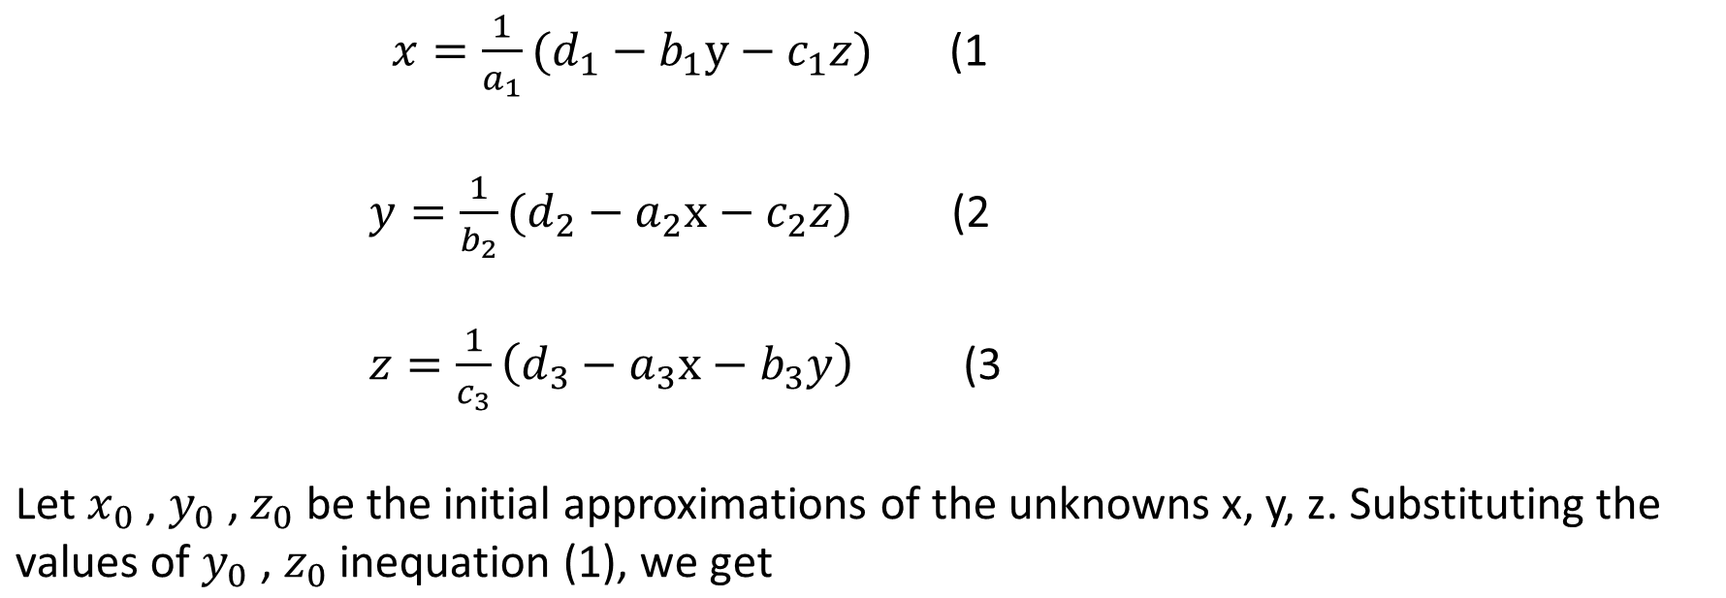
Numerical Methods
National University of Science and Technology, Islamabad

Slide 4
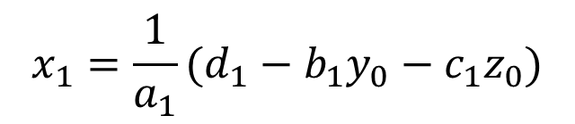
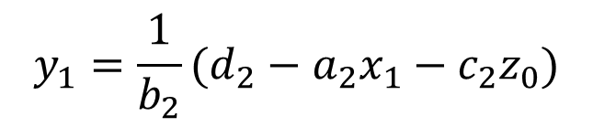
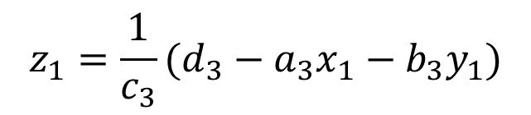
Numerical Methods
National University of Science and Technology, Islamabad

Slide 5

Numerical Methods
National University of Science and Technology, Islamabad

Slide 6

Numerical Methods
This process is continued till the values of x, y, z are obtained to the desired accuracy.
National University of Science and Technology, Islamabad

Slide 7
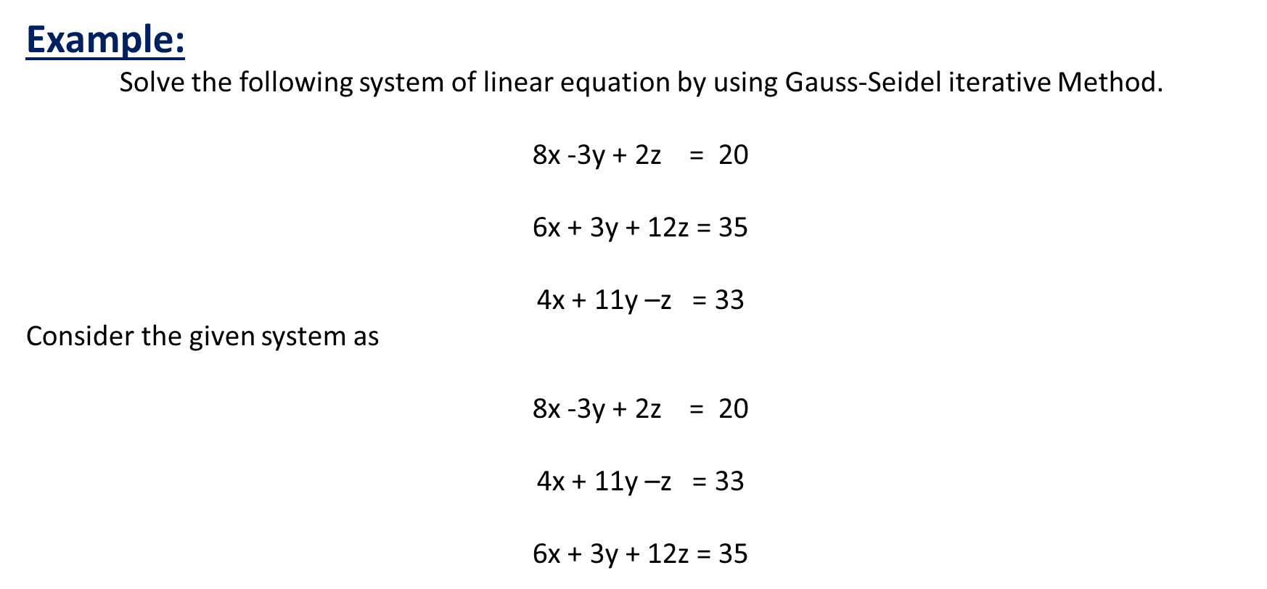
Numerical Methods
National University of Science and Technology, Islamabad

Slide 8
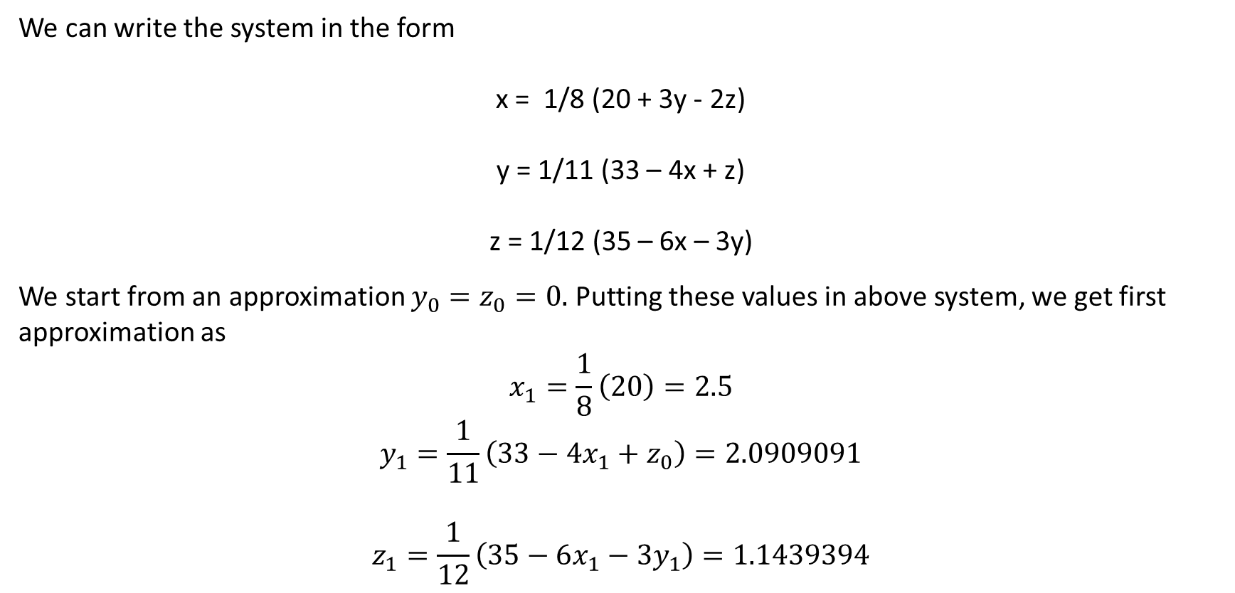
Numerical Methods
National University of Science and Technology, Islamabad

Slide 9
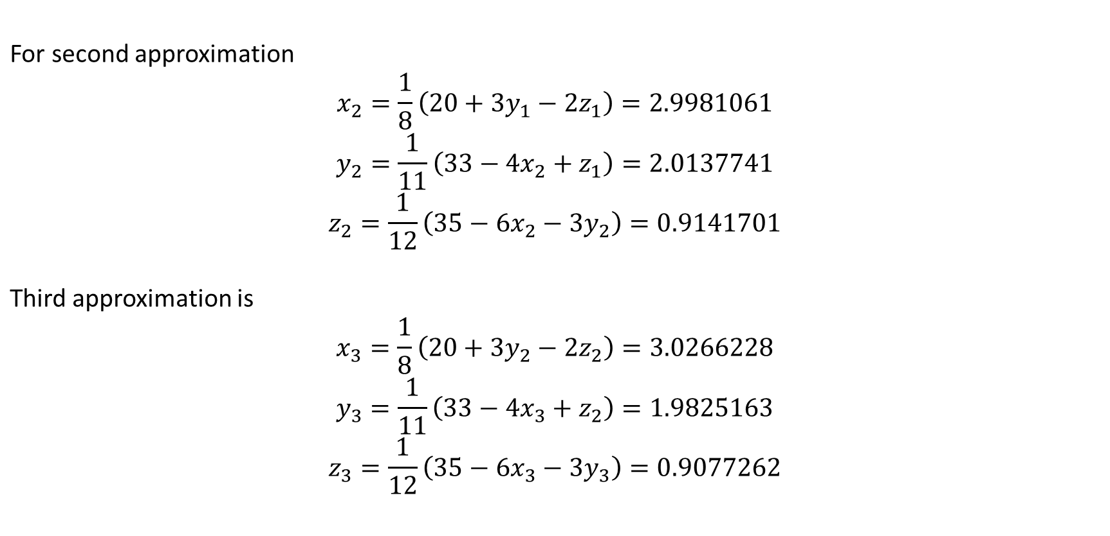
Numerical Methods
National University of Science and Technology, Islamabad

Slide 10
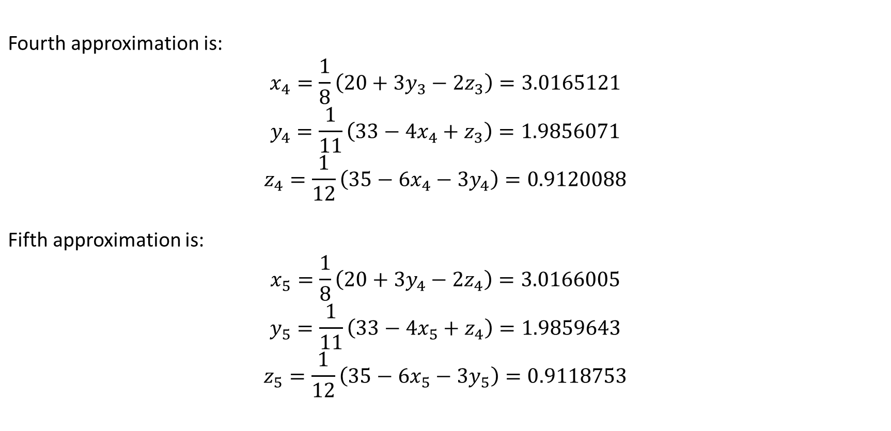
Numerical Methods
National University of Science and Technology, Islamabad

Slide 11
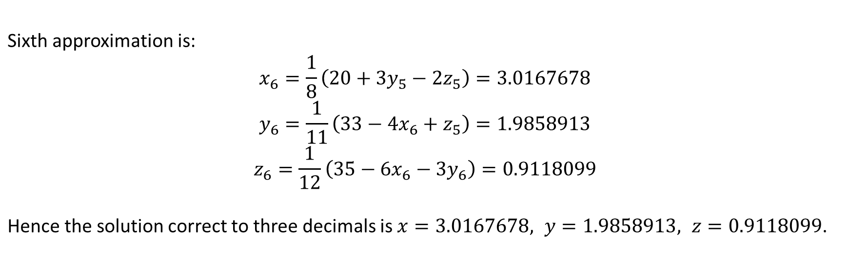
Numerical Methods
National University of Science and Technology, Islamabad

Slide 12
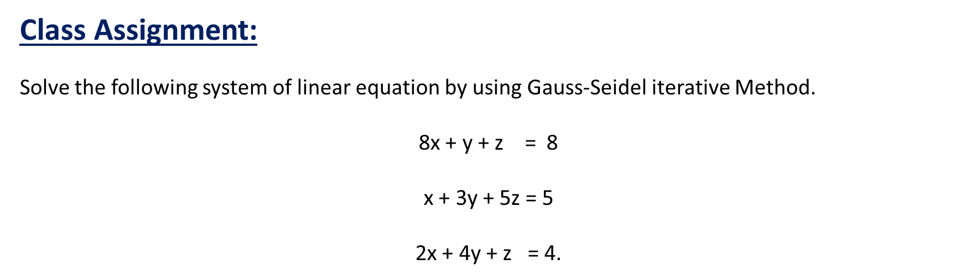
Numerical Methods
National University of Science and Technology, Islamabad

Slide 13
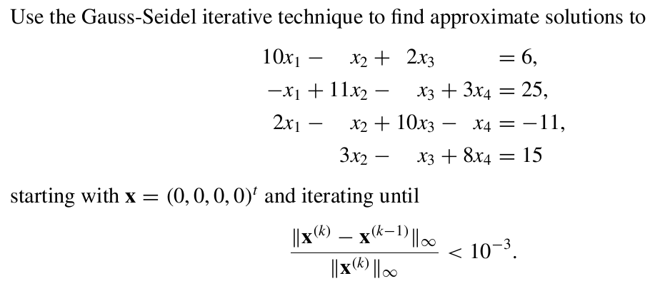
Numerical Methods
Problem
National University of Science and Technology, Islamabad

Slide 14

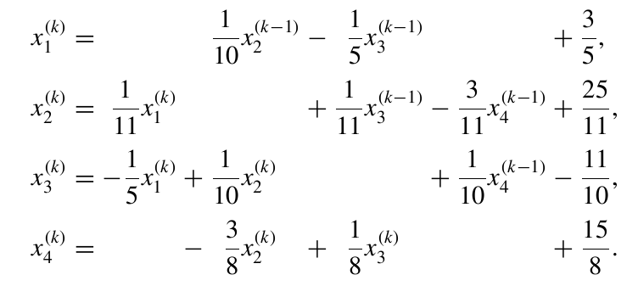
Numerical Methods
National University of Science and Technology, Islamabad

Slide 15
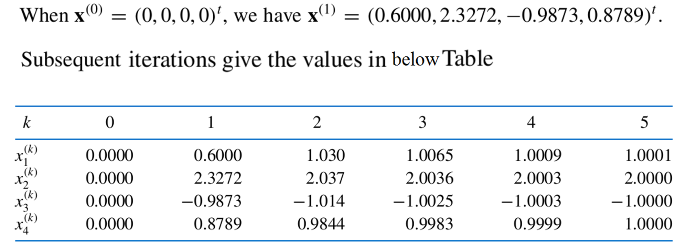
Numerical Methods
National University of Science and Technology, Islamabad

Slide 16
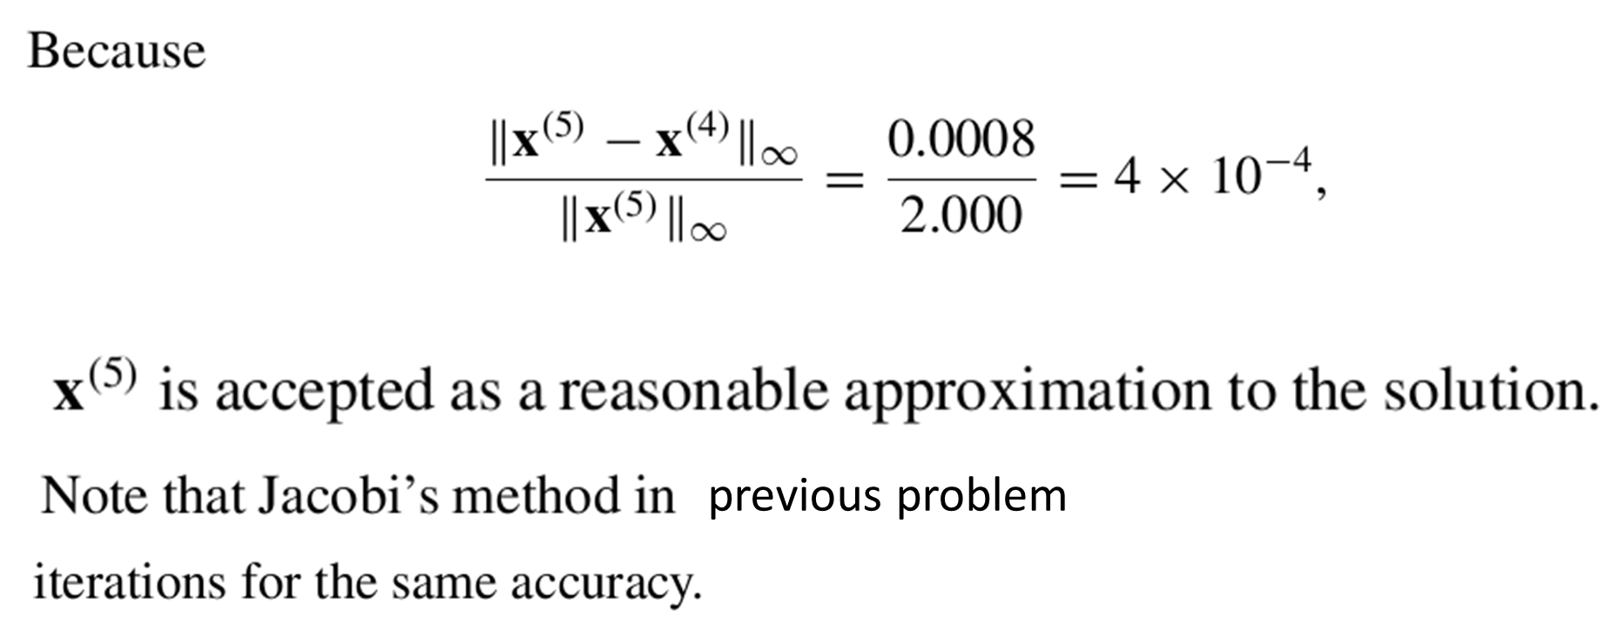
Numerical Methods
National University of Science and Technology, Islamabad

Slide 17
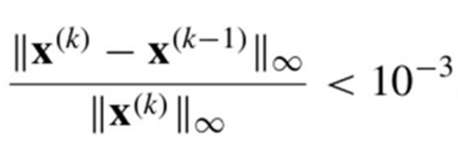
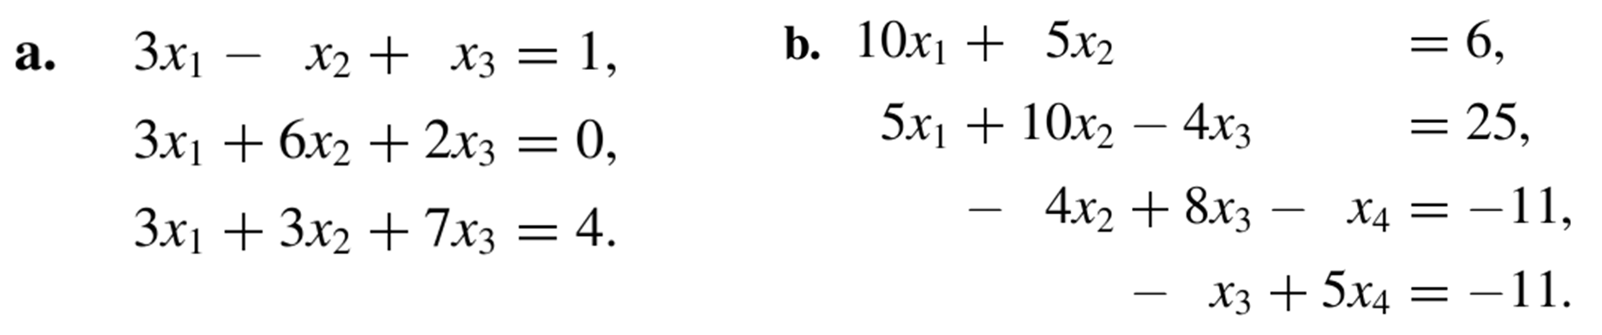
Numerical Methods
Problem 2
In the following problems find the approximate
Solutions by Gauss-Seidel method until
is satisfied.
National University of Science and Technology, Islamabad

Slide 18
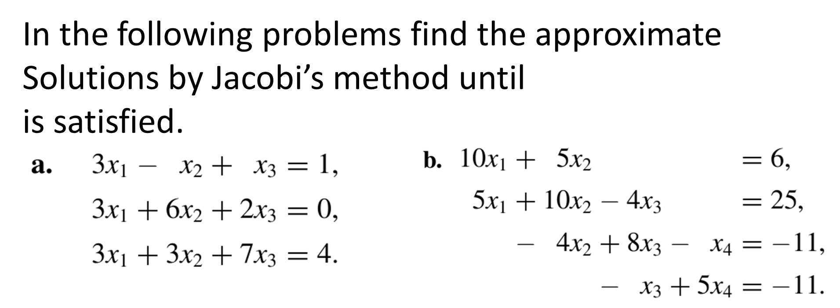
Numerical Methods
National University of Science and Technology, Islamabad

